Slide 1
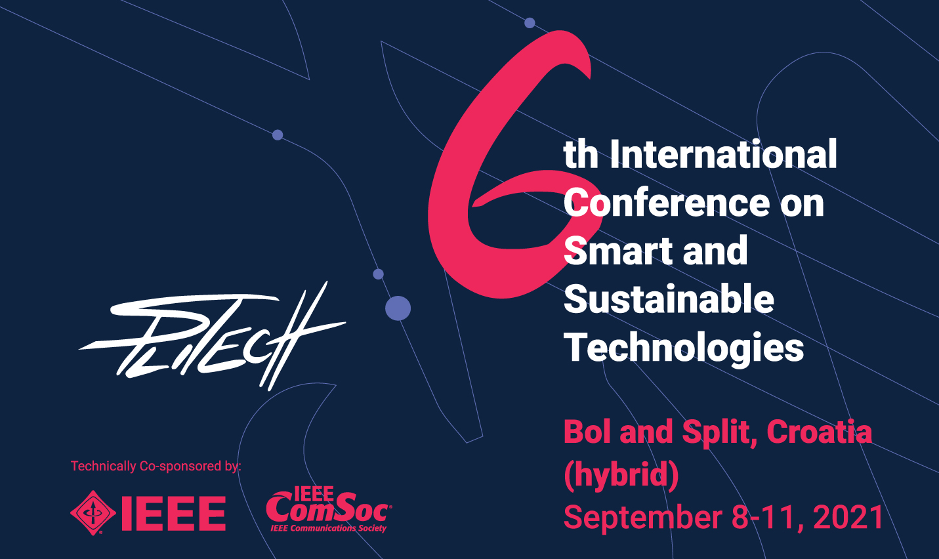
Blockchain Technology based on Algorand applied to
low-power and low-cost IoT devices
T. Montanaro¹, I. Sergi¹, S. Corvaglia¹, L. Mainetti¹, A. Vilei², B. Rossi², A. Palmieri², L. Patrono¹
¹ Department of Engineering for Innovation, University of Salento, Lecce, Italy
² System Research & Applications (SRA), STMicroelectronics Lecce, Italy

Slide 2
Roadmap
Introduction
State of the art
Experiment design
Experimental results
Conclusions and future works

Slide 3
Introduction
One of the major challenges faced in the exploitation of IoT functionalities regards the need of protecting information at all levels.
To this aim, in recent years, the Distributed Ledger Technologies (DLT) and Blockchains are gaining momentum as solutions in such scenarios.
For the purposes of this work the Algorand Blockchain has been selected
for all the performed activities due to its inclination towards the IoT domain.

Slide 4
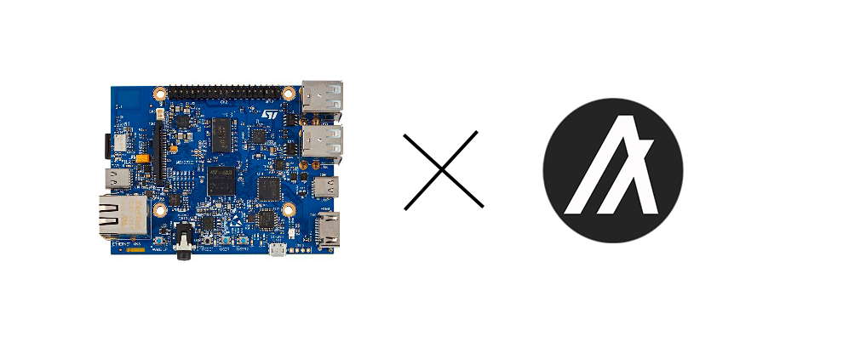
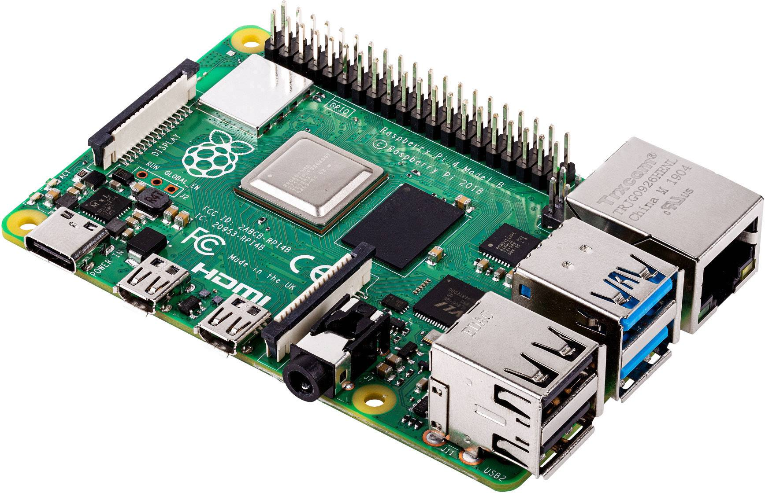
Introduction
The goal of this work regards:
demonstrate, through designed and performed experiments, that it is possible to exploit Algorand on two of the most common embedded IoT devices without any modification in hardware or software.
STMicroelectronics
STM32MP157A-DK1
Raspberry Pi 4 Model B

Slide 5
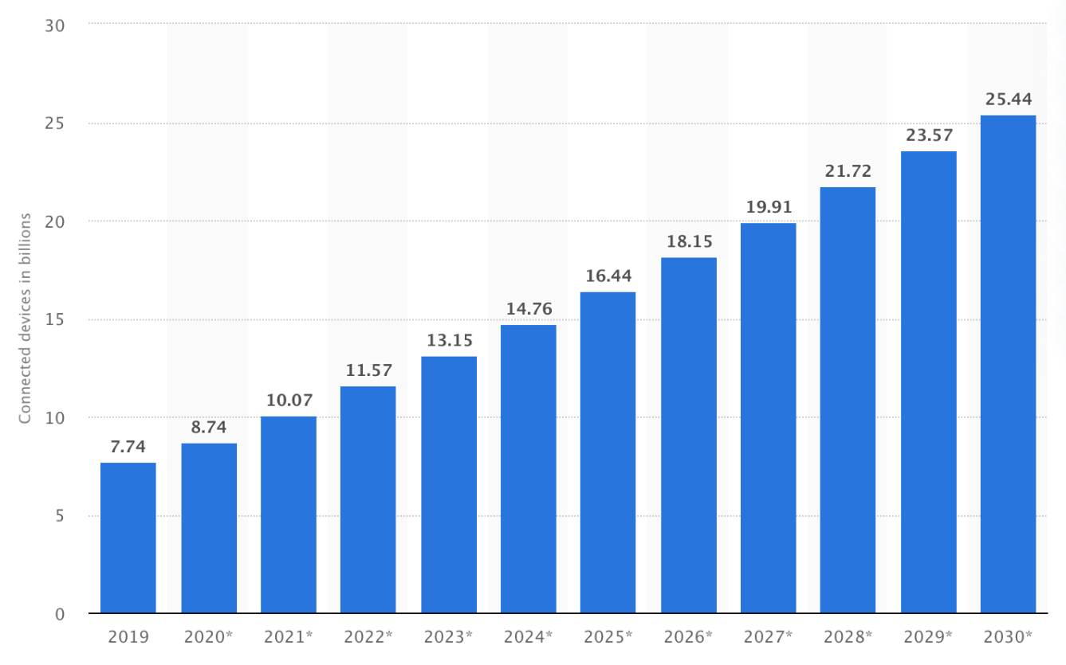
State of the art
Some existing works have already analyzed the applicability of some of the most spread blockchains on low-powered devices, but none of them is focused on the Algorand technology.
Therefore, the state of the art was divided into 2 parts:
the works proposing solutions to apply Blockchain to low-power IoT devices
the works already exploiting Algorand in innovative proposals

Slide 6
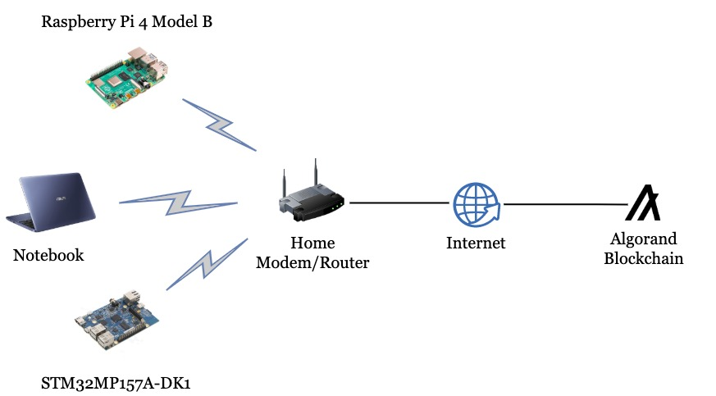
Experiment design
To understand if the Algorand Blockchain can be exploited on a device, it is necessary to verify the fulfilment of the following essential steps:
Run an Algorand node to let it be synchronized with the Network.
Perform Write and Read operations through the run Node.
Setup Topology

Slide 7
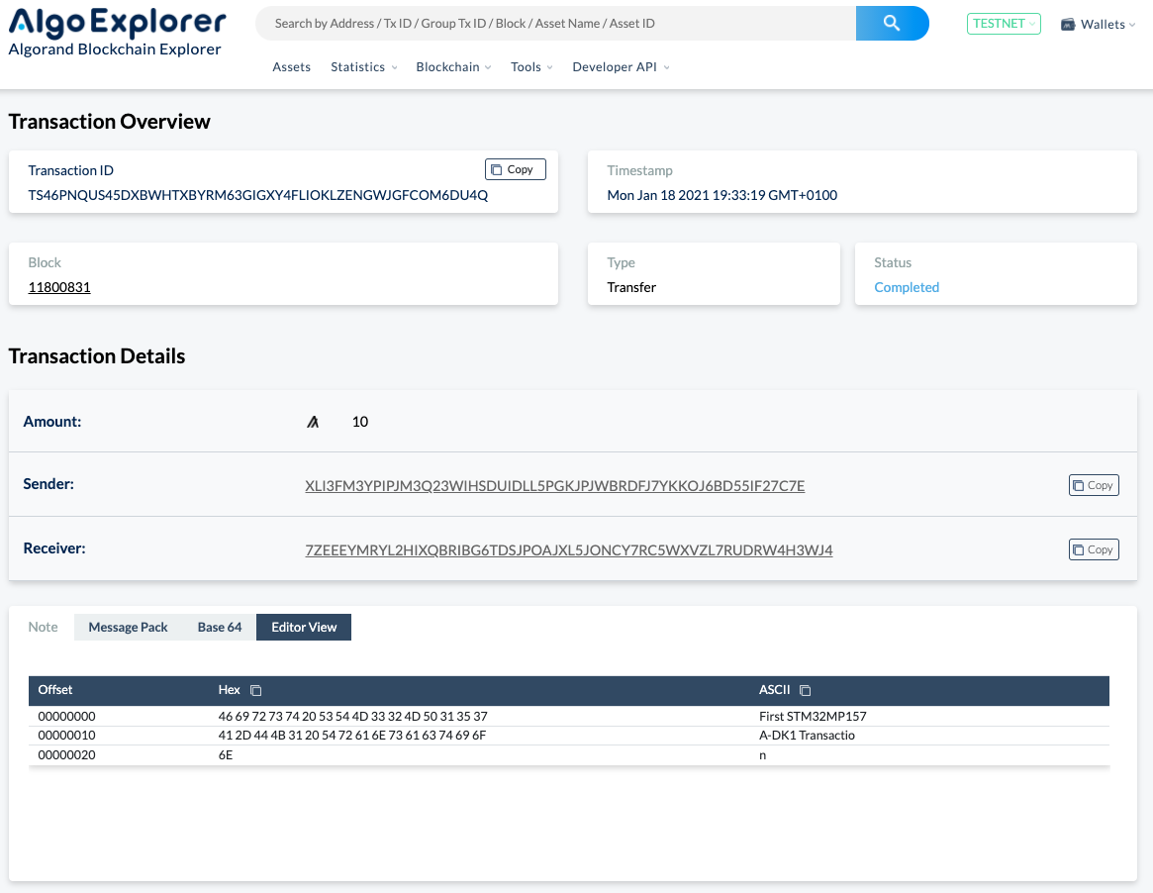
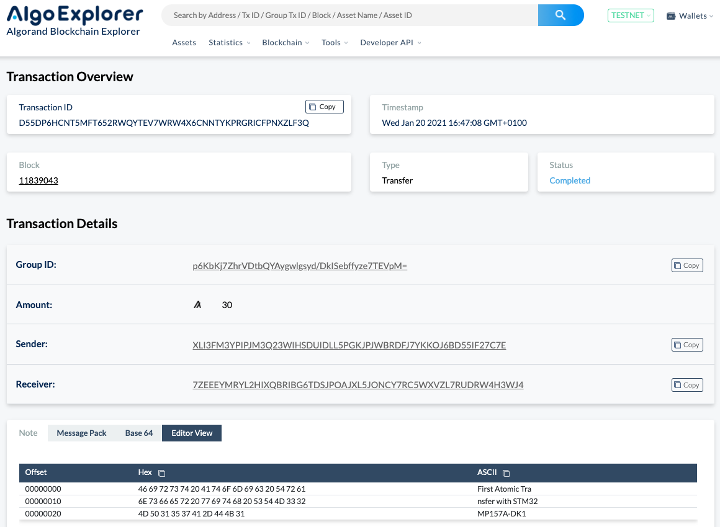
Experimental results
Transaction
Atomic Transfer

Slide 8
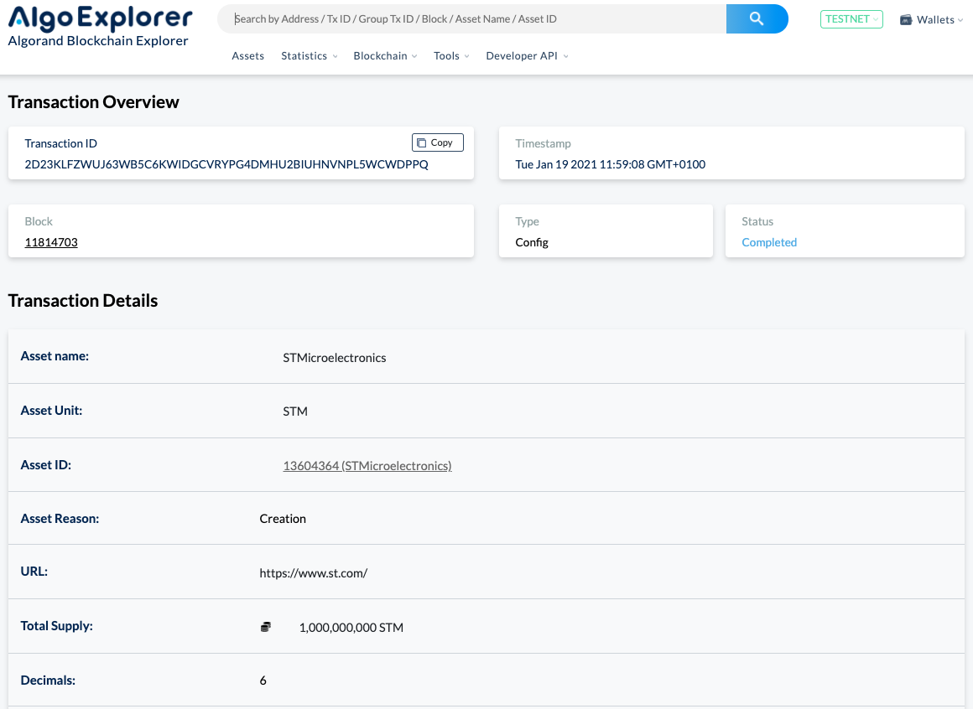
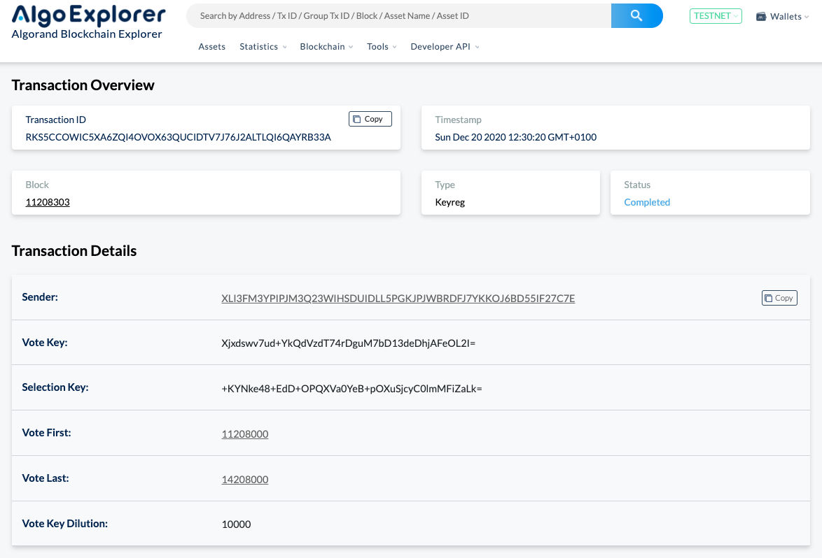
Experimental results
ASA
Key Registration

Slide 9
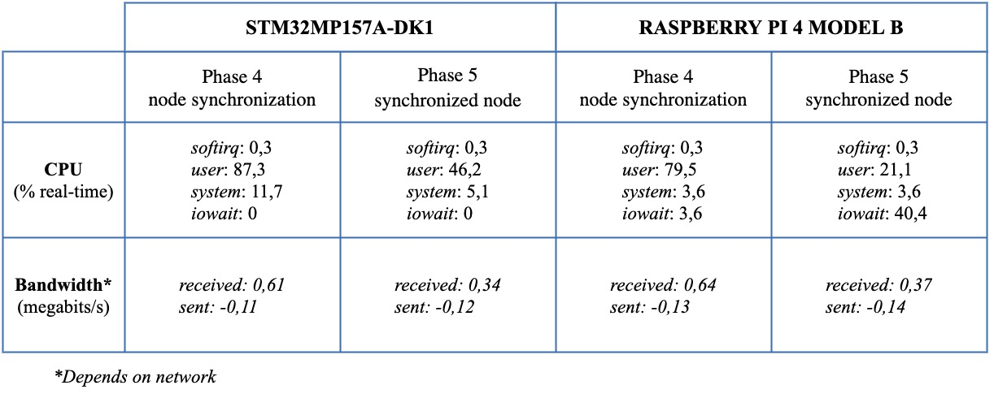
Experimental results

Slide 10
Conclusions and Future works
Applicability of the Algorand Blockchain on low-power devices was demonstrated
STMicroelectronics device is suitable for joining the Algorand network and capable of publishing transactions to the Algorand Blockchain in a few seconds and running some of its functions
Comparison among the exploitation of various Blockchains on IoT low-power devices
Implementation of interesting use cases that could exploit smart contracts for their purposes
Development of a basic C library for Algorand to be used on constrained low-cost devices based on MCU, like STMicroelectronics’ STM32 (Cortex-M Architecture)
Performance analysis on the Algorand MainNet Network

Slide 11
Thanks for your attention!
T. Montanaro¹, I. Sergi¹, S. Corvaglia¹, L. Mainetti¹, A. Vilei², B. Rossi², A. Palmieri², L. Patrono¹
¹ Department of Engineering for Innovation, University of Salento, Lecce, Italy
² System Research & Applications (SRA), STMicroelectronics Lecce, Italy
teodoro.montanaro@unisalento.it
ilaria.sergi@unisalento.it
salvatore.corvaglia@studenti.unisalento.it
luca.mainetti@unisalento.it
antonio.vilei@st.com
beatrice.rossi@st.com
andrea.palmieri@st.com
luigi.patrono@unisalento.it

